Slide 1


Slide 2


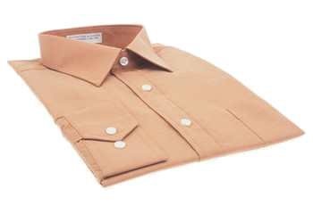
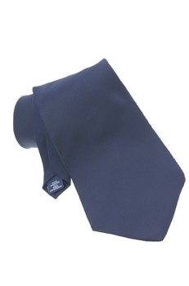
‘s
‘
Alison / skirt
The students / shirts
‘
It’s Alison skirt.
The students shirts are blue.
‘ s
Make sentences. Use the Possessive Case.
1. Bill / shirt
2. Mr Carter / tie
This is _________
Bill’s shirt.
This is ______________
Mr Carter’s tie.

Slide 3
Formation
1 - Singular nouns or proper nouns take ‘s.
e.g.: the boy’s ball, Emily’s car
2- Plural nouns ending in -s take ‘(apostrophe)
e.g. the girls’ house
3- Irregular plural nouns take ‘s.
e.g.: the men’s boat

Slide 4

4 - Same thing belongs to two or more people we add ‘s only to the last noun.
Paul and Tina’s house

Slide 5
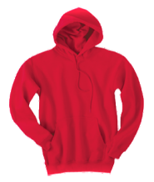
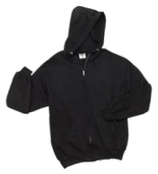
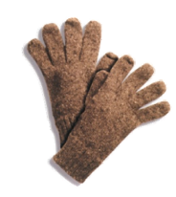
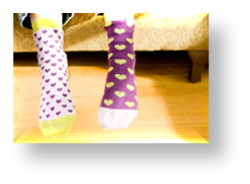
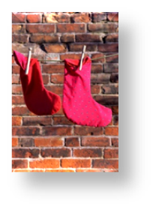
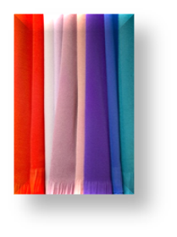
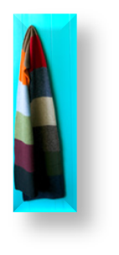
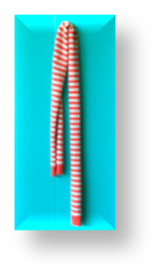
3. The boys / sweatshirts
These are ___________________
the boys’ sweatshirts.
4. Sam / gloves
These are ____________.
Sam’s gloves
5. The girls / socks
These are _____________.
the girls’ socks
6. Alison / scarves
These are ______________.
Alison’s scarves

Slide 6
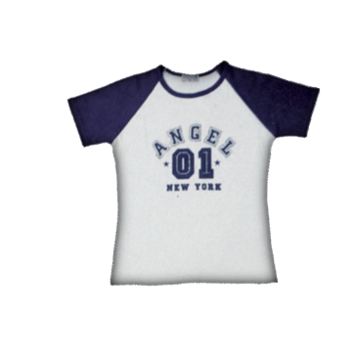

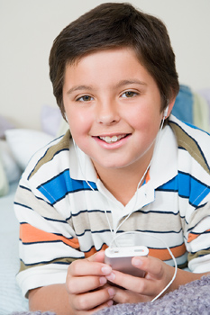

Whose T-shirt is this?
It’s Peter’s T-shirt.
Peter
Ask questions with “Whose”. Give the answers.
1. _____________________________?
Whose shorts are these
Carl /shorts
They are Carl’s shorts.
2. _____________________________?
Whose shirt is this
Sue / shirt
It’s Sue’s shirt.
3. _____________________________?
Whose jackets are these
the students / jackets
They are the students’ jackets.

Slide 7


Whose T-shirt is this?
It’s Mark’s T-shirt.
Mark
Ask questions with “Whose”. Give the answers.
1. _____________________________?
Peter /shirt
2. _____________________________?
the girls / Jackets
3. _____________________________?
the students / jackets

